Slide 1
Evaluation of the Ozone Measurements at Mt. Kenya Global Atmospheric Watch (GAW) Station
KADI- Python & Data Gym Workshop at IRLI Kapiti
28 April 2025 – 01 May 2025
Danid Njiru_Meteorologist

Slide 2
Introduction
Having been introduced for the first time to Python
I chose this project to test my basics in Python and appreciate my understanding to the data generated at the Mt Kenya GAW station
Data was in .txt format
Process was to read the data file and extract the Ozone data (averaged per minute) for a period of one Month, 06 February – 10 March 2024
Main aim was to evaluate daily variations in Ozone Measurements
Its amazing to learn about some powerful Python codes and a host of libraries, Github repositories, ChartGPT and more that support coding
Main challenge was to master the choice of codes to complete the tasks at each stage of importing, opening/reading, extracting and plotting data

Slide 3
Encode; import, open & read content…
file_path = "tei49i_all_lrec-20250310204725.dat"
print(file_path)
#Read file as text and print
with open(file_path, 'r') as file:
for line in file:
file_content = file.read()
print(file_content)

Slide 4
Initial Data file .dat (.txt) and the final data file .csv
07:07 02-06-25 flags 0C105000 o3 42.557 hio3 0.000 cellai 43958 cellbi 43321 bncht 28.1 lmpt 53.0 o3lt 0.0 flowa 0.542 flowb 0.544 pres 492.2
07:08 02-06-25 flags 0C105000 o3 40.946 hio3 0.000 cellai 43959 cellbi 43322 bncht 28.1 lmpt 53.0 o3lt 0.0 flowa 0.542 flowb 0.543 pres 492.5
Over 10,000,000 entries in one Row
Datetime ozone_value ozone
2025-02-06 07:07:00 42.557 o3
2025-02-06 07:08:00 40.946 o3
2025-02-06 07:09:00 38.913 o3
2025-02-06 07:10:00 42.176 o3
2025-02-06 07:11:00 43.295 o3
=[44936 rows x 2 columns]

Slide 5
Import pandas & matplot libraries to plot
import pandas as pd
data = pd.read_csv('kapiti.txt', sep=",")
#print(data.info)
print(data.describe)
#
import matplotlib.dates as mdates
df = pd.read_csv('kapiti.txt', sep=",",parse_dates=['date'])
#print(df)
df.groupby(df.date.dt.day)['ozone_value'].mean().plot()
plt.show()

Slide 6
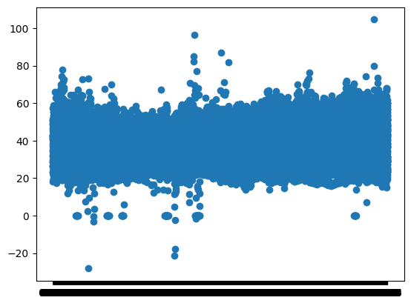
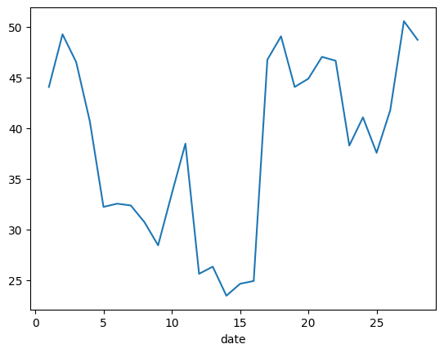
First Run; Scatter plot and Time series
Hourly Values
Daily Values (Mean)

Slide 7
Second attempt; After studying the data content
#.txt file read in pandas; dataframe (df1)in .csv format
df1 = pd.read_csv("kapiti.txt")
df1.to_csv('kapiti_csv.csv', index = None)
df1 = pd.read_csv('kapiti_csv.csv')
df1['Datetime'] = pd.to_datetime(df1['date'] +" "+ df1["time"])
df1.drop(["date","time"], axis=1, inplace=True)
df1.to_csv('kapiti_csv2.csv', index = None)

Slide 8
Import file as Pandas; Combine date and time index (Datetime) and plot
import pandas as pd
test = pd.read_csv("kapiti_csv2.csv")
print(test)
test = pd.read_csv("kapiti_csv2.csv",index_col=0,parse_dates=True)
print(test)
To Plot data
test.plot()
Datetime ozone_value ozone
0 2/6/2025 7:07 42.557 o3
1 2/6/2025 7:08 40.946 o3
2 2/6/2025 7:09 38.913 o3
3 2/6/2025 7:10 42.176 o3
4 2/6/2025 7:11 43.295 o3
... ... ... ...
44931 3/10/2025 21:23 33.886 o3
44932 3/10/2025 21:24 30.961 o3
44933 3/10/2025 21:25 30.074 o3
44934 3/10/2025 21:26 31.637 o3
44935 3/10/2025 21:27 29.592 o3
[44936 rows x 3 columns]

Slide 9
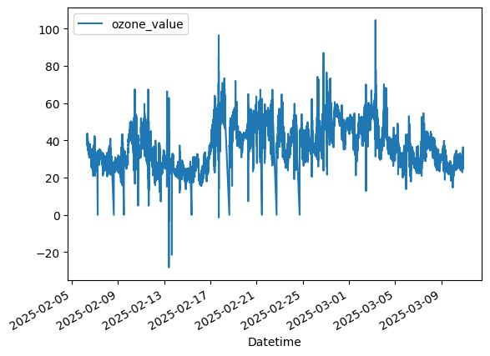
Time series plot of Ozone data

Slide 10
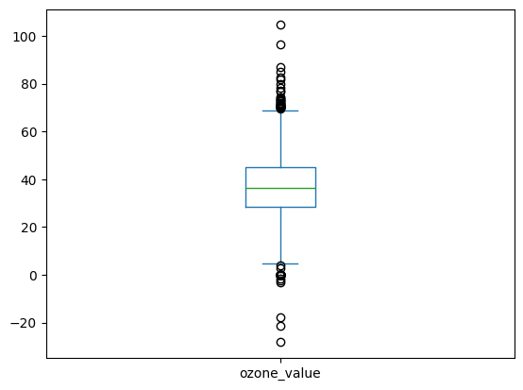
Box plot for Spread from the Mean
test.plot.box()

Slide 11
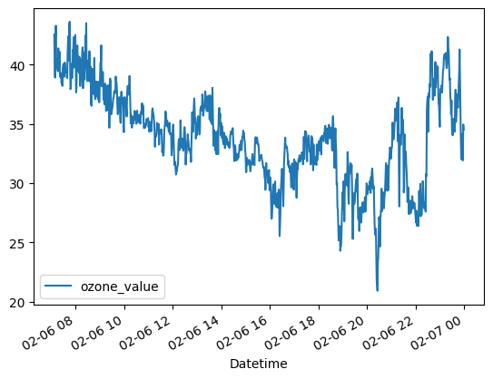
Daily Variations Averaged per Minutes(24hrs)
daily=test.groupby(test.index.date)
daily.plot()

Slide 12
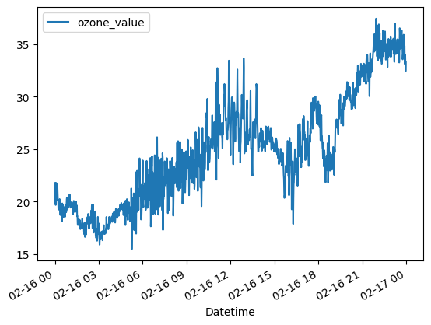
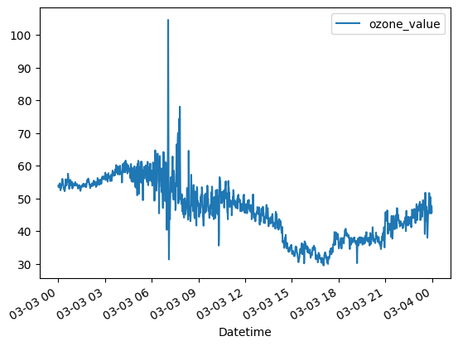
Peculiar Readings

Slide 13
Summary
“If you can't fly then run, if you can't run then walk, if you can't walk then crawl, but whatever you do you have to keep moving forward.”
Martin Luther King, Jr.

